Slide 1
AEM 2210
Financial Accounting
Chapter 11: Reporting and Interpreting Stockholders’ Equity
Professor Sinclair
Spring 2018

Slide 2
Chapter 11 Learning Objectives
Explain the role of stock in the capital structure of a corporation
Compute and analyze the earnings per share ratio
Describe the characteristics of common stock and report common stock transactions
Discuss and report dividends
Compute and analyze the dividend yield ratio
Discuss and report stock dividends and stock splits
Describe the characteristics of preferred stock and report preferred stock transactions
Discuss the impact of stock transactions on cash flows

Slide 3
Where we are on the Income Statement
Income Statement for FY 2016
Revenues | 1,000
COGS | (600)
Gross Profit | 400
SG&A | (305)
Operating Income | 95
Interest Expense | (16)
Other Income (Expense) | (4)
Gains (Losses) | 25
Earnings before Taxes | 100
Tax Expense | (35)
Net Income | 65
EPS | 0.065
NOWHERE! Transacting with shareholders
does NOT affect a firm’s income statement

Slide 4
Where we are on the Balance Sheet
Balance Sheet as of 12/31/2016
Assets |  |  | Liabilities
Cash | 200 |  | Accounts Payable | 100
Accounts Receivable, gross | 200 |  | Salaries Payable | 30
(Allow. For Doubtful Accounts) | (10) |  | Current Portion of LT Debt | 50
Investments in Other Companies | 100 |  | Other | 70
Inventory | 230 |  | Current Liabilities | 250
Prepaid Assets | 120
Current Assets | 840 |  | Warranty Liabilities | 20
 |  |  | Contingent Liabilities | 40
PP&E, gross | 1000 |  | Deferred Tax Liabilities, net | 80
(Accumulated Depreciation) | (250) |  | Capital Lease Obligation | 100
Intangibles, net | 150 |  | Bonds, net | 600
Long-term Assets | 900 |  | Long-term Liabilities | 840
 |  |  | Owners’ Equity
 |  |  | Common Stock | 50
 |  |  | APIC | 450
 |  |  | Treasury Stock | (10)
 |  |  | Other | 10
 |  |  | Retained Earnings | 150
 |  |  | Owners’ equity | 650
Total Assets | 1740 |  | Total Liabilities & OE | 1740

Slide 5
Advantages of a Corporation
The corporate form of organization has several advantages.
The major advantage is the ease of raising large amounts of money because both large and small investors can participate in corporate ownership. It is simple to become an owner of corporate shares of stock, and it is just as simple to sell the shares. Organized exchanges, such as the New York Stock Exchange, maintain markets in which shares in thousands of companies are bought and sold each business day.
Another advantage is limited liability. Stockholders’ losses are limited to the amount invested in the corporation. Corporate creditors cannot make claims on the personal assets of shareholders to satisfy corporate debt.
Corporations are easy to own and often offer investors a higher return than investing in corporate bonds or depositing money into a bank account. Unfortunately, stock ownership also carries some risk.

Slide 6
Characteristics of a Corporation
Corporations are the dominant form of business, in terms of volume of operations.
Corporations are entities created by law that exist separately from their owners and that have rights and privileges. As separate entities, corporations can:
own assets
incur liabilities
expand and contract in size
sue and be sued
enter into contracts

Slide 7
Owners’ Equity

Slide 8
Owners’ Equity
Assets = Liabilities + Owners’ Equity
Assets - Liabilities = Owners’ Equity
Represents stockholders’ interest in the firm’s assets remaining after all liabilities have been satisfied
Also referred to as ‘residual interest’ because shareholders are the residual claimants of the firm

Slide 9
Shares of Stock

Slide 10
Benefits of Stock Ownership
In addition to being able to vote on important issues at annual meetings, stockholders have other benefits. Stockholders have the right to receive dividends when declared by the board of directors. In the event of a liquidation, stockholders share, according to their percentage ownership, in any remaining assets after creditors are paid.

Slide 11
Authorized vs. Issued vs. Outstanding Shares
Authorized Shares
Issued Unissued
Authorized shares that have been sold
Authorized shares that have not been sold
The authorized number of shares is the maximum number of shares of stock that can be issued to the public. The number of authorized shares is identified in the corporate charter of the corporation that is issued by the state.
Authorized shares are either issued or unissued. Unissued shares are shares of stock that have never been sold to the public. Issued shares are shares of stock that have been sold to the public.

Slide 12
Authorized vs. Issued vs. Outstanding Shares
Authorized Shares
Issued Unissued
Issued shares owned by stockholders
Outstanding shares
Authorized shares that have not been sold
Treasury shares
Issued shares previously owned by stockholders that have been repurchased (but not retired) by the firm

Slide 13

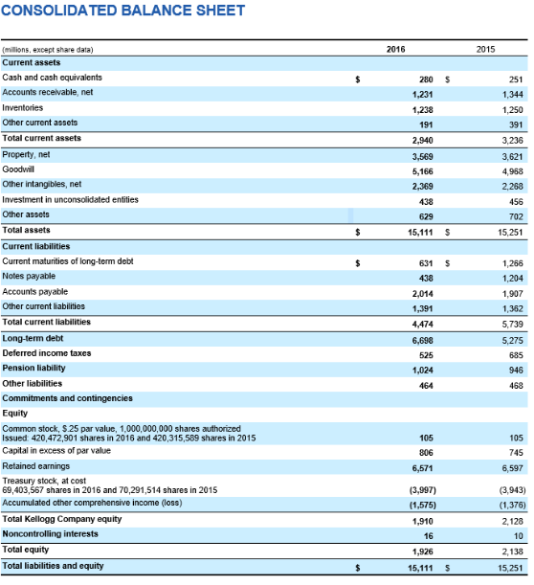
Kellogg’s Shares Outstanding
What is Kellogg’s # of common shares outstanding at FY2016?
Shares Issued = Shares Outstanding + Shares Repurchased

Slide 14
Earnings per Share (EPS)

Slide 15
Earnings Per Share (EPS)
Net Income – Preferred Dividends
Average # of Common Shares Outstanding
Basic EPS =
Measures profitability per share of common stock available to common stockholders
The most highly publicized summary of a firm’s annual economic performance
Diluted EPS =
What would give rise to “potentially dilutive common shares”?
Convertible bonds and convertible preferred stock
Employee stock options (ESOs) granted but not yet exercised
Restricted stock units (RSUs)
Earnings per share is one of the most widely quoted financial ratios. It is a measure of the company’s ability to produce income for each common share outstanding.
Net Income – Preferred Dividends
(Avg. # of Common Shares Outstanding + Avg. # of Potentially Dilutive Common Shares)
Accounting for these
topics is beyond the scope of AEM 2210

Slide 16

Diluted EPS at Apple

Slide 17
What Makes a Security ‘Anti-Dilutive’?
Diluted EPS must be ≤ basic EPS
Diluted EPS computation assumes conversion at the beginning of the year, and conversion can also affect the EPS numerator
Convertible bonds: No interest expense would have been accrued
Convertible preferred stock: No dividend would have been declared
If the diluted EPS calculation yields a value > basic EPS, remove “antidilutive” potential conversions

Slide 18
What Makes a Security ‘Anti-Dilutive’?
Example:
Kellogg reports basic EPS of $1.98 and diluted EPS of $1.96. Assume that Kellogg has issued 100 convertible bonds. Kellogg incurs $12,000 of interest expense related to these bonds each year. Each bond can be converted into 40 shares of the common stock. The tax rate is 30%.
Are these convertible bonds considered dilutive or anti-dilutive?

Slide 19
Common Stock Transactions
Corporations have two primary sources of equity.
The first is contributed capital. The two accounts in contributed capital are:
Common Stock, par value*
Additional Paid-in-Capital (APIC, Common Stock)*
These accounts represent amounts that shareholders have invested by buying shares of stock from the company.
The second source of equity is retained earnings. The retained earnings account reports the cumulative amount of net income the corporation has earned since its organization less the cumulative amount of dividends declared since organization. This is the portion of the net income that has been reinvested in the business rather than distributed to the owners in dividends.
Common stock is the basic voting stock of the corporation. It represents the residual claim on assets in liquidation. Dividends paid must first satisfy preferred stock agreements before any distribution can be made to common stockholders.
*Note: Under IFRS, Common Stock is called ‘Share Capital’; and Additional Paid-in-Capital is called ‘Share Premium’

Slide 20
Par Value
Par Value is the nominal value, established by the corporate charter, assigned to each share of common and preferred stock
Original purpose: protect creditors
Each state specifies a legal minimum capital amount stockholders are not allowed to withdraw from the firm
Some states do not require a par value to be stated in the charter
Today:
Common stock par value is generally a very low and arbitrary amount
Preferred stock par value determines the dividend amount per share
Example: $20 par, 10% preferred stock indicates the preferred dividend is $2/share (= $20 par * 10%)
Par value is a nominal amount and is not related in any manner to market value, which is the selling price of a share of stock

Slide 21
Initial Sale of Stock
At the initial public offering, shares of stock are sold to the public for the first time, usually through major securities brokerage firms with retail offices in cities across the country. At a later date, the company may wish to raise additional capital with another sale of stock to the public. This is referred to as a seasoned new issue (or Seasoned Equity Offering).
Firm A issues 1,000 shares of common stock with a $0.01 par value for $100 per share. How would Firm A account for this transaction?
When par value stock is sold for cash, the Common Stock account is credited for the par value of the stock sold. The difference between the par value of the stock and the market value of the stock is credited to Additional Paid-in Capital. When added together, the amount of par value in the Common Stock account and the amount in the Additional Paid-in Capital account are equal to the market value of the sale of the stock.
To record the sale of stock | Debit | Credit
Cash (+A) | $100,000
Common Stock (+SE) |  | $ 10
APIC (+SE) |  | 99,990

Slide 22
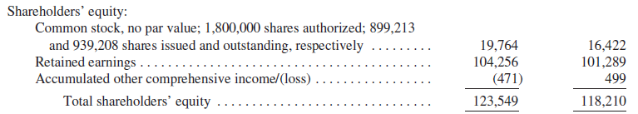
No Par Stock
The accounting entry for no-par, stated value stock is very similar to accounting for par value stock. When a company has no-par stock, all the proceeds are credited to the Common Stock account.
No APIC account required
Apple’s Shareholder’s Equity Section

Slide 23
Other Common Stock Activities
Once shares of stock are owned by the public, they may be bought and sold in the open market. Such transactions do not involve the company or its accounting records. The millions of shares that are bought and sold on the New York Stock Exchange each business day are examples of this type of transaction.
Many corporations have employee compensation packages that include both salary and stock options. Most stock option plans allow employees to buy shares of stock from the corporation at a predetermined, fixed price. If the company granting the options to its employees does not have unissued shares of stock to sell to employees when the stock options are exercised, the company can repurchase the shares. Repurchased shares are called treasury stock.
In addition to repurchasing shares for employee stock option plans, companies buy their own stock to support the market price, to increase shares needed to use in the acquisition of another company, to limit the shares available for a hostile takeover, and to return cash to shareholders who wish to sell their shares.
Treasury stock has no voting or dividend rights. Treasury stock is not an asset. It is a contra-equity account and is subtracted from the stockholders’ equity section on the balance sheet. Treasury stock is usually recorded at the cost to purchase it, and the total cost of all shares of treasury stock held by the company is the amount reported as a reduction in stockholders’ equity.

Slide 24
Repurchasing Stock

Slide 25
Repurchasing Stock
Why do firms buy back their own stock?
Shares needed for employee stock option grants and acquisitions
If capital gains tax rate < dividends tax rate, repurchases are a more tax-efficient method of returning capital to shareholders
Management signaling the firm’s stock is “undervalued” by the market
Boost EPS by decreasing the denominator
Maintain control over the firm; thwart hostile takeovers
Accounting for repurchases depends on managers’ intent to resell the shares at a future date:
If intent to resell: use ‘Treasury Stock (C-OE)’ account
If no intent to resell: retire shares and reduce ‘Common Stock (OE)’ and ‘APIC-Common Stock (OE)’ accounts

Slide 26
Repurchasing Stock Example
On March 15, 2000, Firm C issued 100,000 shares of $1 par value stock for $30/share:
DR Cash (A) 3,000,000
CR Common Stock (SE) 100,000
CR APIC (SE) 2,900,000
On January 15, 2014, Firm C repurchases 1,000 of these shares for $35/share. This is the first time the firm has ever repurchased its own shares. The firm intends to resell the shares at a future date. How would Firm C account for this transaction?

Slide 27
Repurchasing Stock Example
On March 2, 2014 Firm C sells 100 treasury shares for $37 per share. How would Firm C account for this transaction?
Increases in the ‘APIC-Treasury Stock’ balance indicate a firm has resold its treasury shares for a higher price than it paid when repurchasing the shares (“good market timing”)

Slide 28
Repurchasing Stock Example
On August 18, 2015 Firm C needs some additional cash and sells 100 additional treasury shares for $32 per share. How would Firm C account for this transaction?
Summary:
When the “plug” is an increase to OE, increase ‘APIC-Treasury Stock’
When the “plug” is a decrease to OE, reduce ‘APIC-Treasury Stock’ down to zero and then decrease ‘Retained Earnings’

Slide 29
Repurchasing Stock Example
How would Firm C have accounted for the 1,000 repurchased shares if the firm had no intention of ever reissuing the shares? Recall 100,000 shares with $1 par were originally sold for $30/share:
DR Cash (A) 3,000,000
CR Common Stock (OE) 100,000
CR APIC (OE) 2,900,000
How does Firm C account for the repurchase and retirement of the 1,000 shares repurchased at $35/share?

Slide 30
Repurchasing Stock Example
What if Firm C’s shares had been trading at $28/share when the firm repurchased and immediately retired the 1,000 shares?
Summary:
When the “plug” is an increase to OE, increase ‘APIC-Stock Retirement’
When the “plug” is a decrease to OE, reduce ‘APIC-Stock Retirement’ down to zero and then decrease ‘Retained Earnings’

Slide 31
Repurchasing and Retiring Stock at Apple
Apple’s Statement of Owners’ Equity
Share price at repurchase/retirement must have been > share price at issuance

Slide 32
Dividends

Slide 33
Dividends on Common Stock
Dividends are one of the reasons that investors buy common stock. Cash dividends are declared by the board of directors. There is no legal obligation to declare a cash dividend, but once declared, there is a legal obligation to pay the dividend. Most corporations that pay cash dividends pay them quarterly. To pay a cash dividend, a corporation must have sufficient retained earnings to absorb the dividend without going negative and enough cash to pay the dividend.
The first important date to remember when discussing dividends is the date of declaration. The date of declaration is the date the directors declare the dividend. At this time, a liability is created and must be recorded. The entry at the date of declaration includes a debit to Retained Earnings and a credit to Dividends Payable.
To record dividend declaration | Debit | Credit
Retained Earnings (-SE) | $XX
Dividends Payable (+L) |  | $XX

Slide 34
Dividends on Common Stock
The date of record is also important because it is the date when the corporation determines the current stockholders who will receive the dividend. No entry is required in the accounting records on this date.
The date of payment is the date the corporation pays the dividend to the stockholders who owned the stock on the record date. The entry on the date of payment includes a debit to Dividends Payable and credit to Cash for the total amount of cash paid to the owners of record.
To record dividend payment | Debit | Credit
Dividends Payable (+L) | $XX
Cash (-A) |  | $XX

Slide 35
Dividends on Common Stock
The ex-dividend date is the date two days before the date of record. This date is established by the stock exchanges to account for the fact that it takes time to officially transfer stock from a seller to a buyer.
If someone buys stock before the ex-dividend date, they will be listed as the owner and paid the dividend. If someone buys stock on or after the ex-dividend date, the previous owner will be listed as the owner of the dividend.
If you follow stock prices, you will notice they often fall on the ex-dividend date. The stock is worth less on that date because it no longer includes the right to receive the next dividend.

Slide 36
Stock Dividends

Slide 37
Stock Dividends
A stock dividend is a distribution of additional shares of stock to stockholders. All stockholders retain the same percentage ownership. The stockholders have more shares of stock representing the same ownership as they had before the stock dividend. There is no change in total stockholders’ equity or in the par value per share.
Why do corporations issue stock dividends?
Reduce the market price per share of stock to make the shares more affordable for investors to purchase.
Signal that the management expects strong financial performance in the future.

Slide 38
Stock Dividends
A stock dividend can be classified as small or large.
A small stock dividend is a distribution of stock that is less than 20–25 percent of the outstanding shares. Small stock dividends are recorded at the market value of the stock.
A large stock dividend is a distribution of stock that is greater than 20–25 percent of the outstanding shares. Large stock dividends are recorded at the par value of the stock.
Most stock dividends are classified as large.
When a stock dividend occurs, the company must transfer an additional amount from the Retained Earnings account (or the Additional Paid-in Capital account if there is not a sufficient balance in Retained Earnings) into the Common Stock account to reflect the additional shares issued.

Slide 39
Stock Dividends Example
Firm C issued a large stock dividend. The company issued 50 million shares of its $1 par value stock.
Notice that the stock dividend did not change total stockholders’ equity. It changed only the balances of some of the accounts that constitute stockholders’ equity.
A small stock dividend entry includes a credit to Common Stock and Additional Paid-in Capital since the entry is made at market value.
To record stock dividend | Debit | Credit
Retained Earnings (-SE) | $50,000,000
Common Stock (+SE) |  | $50,000,000

Slide 40
Stock Splits

Slide 41
Stock Split
A stock split is the distribution of additional shares of stock to stockholders according to their percent ownership. When a stock split occurs, the corporation calls in the outstanding shares and issues new shares of stock. In the process of a stock split, the par value per share of the stock changes. Each shareholder has the same percentage ownership of the company after the split as he or she did before the split.
Assume that a corporation has 3,000 shares of $2 par value common stock outstanding before a two-for-one stock split. After the two-for-one split, the number of shares doubles and the par value is cut in half. Notice that an accounting entry is not required and that retained earnings is not reduced.
In many respects, a 100 percent stock dividend and a two-for-one stock split result in similar effects on the price per share in the stock market. The stock split usually requires more administrative tasks to call in and reissue stock certificates.

Slide 42
Stock Split
Changes # of shares authorized, issued, outstanding, and in treasury, but no change in each shareholders’ ownership percentage
So why would a firm declare a stock split?
Market Capitalization = Price per Share * # Shares Outstanding
Stock splits do not affect firm value but do affect # shares outstanding, so price per share is mechanically affected
No journal entry required; just adjust the # of shares and par value on the balance sheet

Slide 43
Stock Split Example
Firm Z issues a 4-for-1 stock split:
Owners’ Equity Before the Stock Split
Common Stock ($2.00 par value; 1,000 shares issued and outstanding) 2,000
APIC 400
Retained Earnings 600
Total Owners’ Equity 3,000
Owners’ Equity After the Stock Split
Common Stock ($0.50 par value, 4,000 shares issued and outstanding) 2,000
APIC 400
Retained Earnings 600
Total Owners’ Equity 3,000

Slide 44
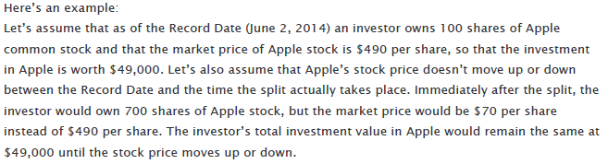
Apple’s 7-for-1 Stock Split in 2014 (FAQ)

Slide 45
Apple’s Dividend History

Slide 46
Apple’s Shares Outstanding After Stock Split
Apple’s EPS Disclosure in 2013:
Apple’s EPS Disclosure in 2014:

Slide 47
Preferred Stock Transactions

Slide 48
Preferred Stock
Preferred stock is a separate class of stock that typically has priority over common stock in dividend distributions and distribution of assets in a liquidation (thus making it less risky than common stock). Preferred stock usually has a stated dividend that is expressed as a percentage of its par value. It normally does not have voting rights.

Slide 49
Preferred Stock
Preferred stock has a current dividend preference when compared to common stock. Current preferred dividends must be paid to preferred stockholders before any dividends are paid to common stockholders.
Cumulative preferred stockholders have the right to be paid both the current and all prior periods’ unpaid dividends before any dividends are paid to common stockholders. When the preferred stock is cumulative and the directors do not declare a dividend to preferred stockholders, the unpaid dividend is called a dividend in arrears and must be disclosed in the financial statements.
Noncumulative preferred stock has no rights to prior periods’ dividends if they were not declared in those prior periods.

Slide 50
Preferred Stock
Company X has the following stock outstanding:
Preferred stock: 6 percent, $20 par, 2,000 shares
Common stock: $10 par, 5,000 shares
Scenario 1:
If Company X issues a $3,000 current dividend, the current dividend preference would be allocated as follows:
Preferred: $20 par value × 0.06 × 2,000 shares = $2,400
Common: $3,000 − $2,400 = $600
Scenario 2:
If Company X issues a $30,000 cumulative dividend and there was no dividend issued in the previous two years, the allocation would be as follows:
Preferred: $2,400 current + ($2,400 in arrears × 2 years) = $7,200
Common: $30,000 − $7,200 = $22,800

Slide 51


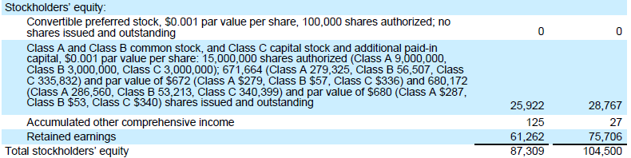

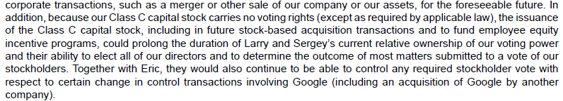
Dual Class Common Stock
No difference in accounting but big difference in voting rights
Google’s Shareholder’s Equity Section

Slide 52
Ratio Analysis

Slide 53
Dividend Yield
How much income will investors receive in the form of dividends?
Investors are interested in the amount of income they will receive in the form of dividends. One comparison that investors make is based on dividend yield. To calculate the dividend yield ratio, we divide the annual dividend per share by the market price per share of the company’s common stock.
In 2014, Whole Foods paid a dividend of $0.48 per share, and the market price of a share of Whole Foods stock was $37.67. The dividend yield for 2014 was 1.3 percent, an increase of 0.7 percent from 2012 and a decrease of 1.1 percent from 2013.
Dividends per Share
Market Price per Share
=
Dividend Yield

Slide 54
Cash Flows

Slide 55

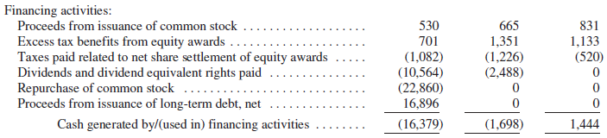
Revisiting the Statement of Cash Flows
Cash from transacting with shareholders is a financing cash flow
Issuing stock for cash and selling treasury stock for cash results in cash inflows. Purchasing treasury stock with cash and paying cash dividends results in cash outflows. These cash flows are reported in the Financing Activities section of the statement of cash flows.
Apple’s Statement of Cash Flows:

Slide 56
Practice Problems
[work on your own]

Slide 57
Transacting with Shareholders: Practice Problems
Indicate if the transaction increases (+), decreases (–), or has no effect (NE) on the accounting equation.
Transaction | Assets | = | Liabilities | + | OE
1. Issue Stock
2. Repurchase Stock
3. Sell Treasury Stock
4. Declare Cash Dividend
5. Pay Cash Dividend
6. Stock Dividend
7. Stock Split

Slide 58
Transacting with Shareholders: Practice Problems
Indicate if the transaction increases (+), decreases (–), or has no effect (NE) on the accounting equation.
Transaction | Assets | = | Liabilities | + | OE
1. Issue Stock | + |  | NE |  | +
2. Repurchase Stock | - |  | NE |  | -
3. Sell Treasury Stock | + |  | NE |  | +
4. Declare Cash Dividend | NE |  | + |  | -
5. Pay Cash Dividend | - |  | - |  | NE
6. Stock Dividend | NE |  | NE |  | NE
7. Stock Split | NE |  | NE |  | NE

Slide 59
Transacting with Shareholders: Practice Problems
Underlying journal entries:
1. DR Cash (A) XX
CR Common Stock (OE) XX
CR APIC-Common Stock (OE) XX
2. DR Treasury Stock (C-OE) XX
CR Cash (A) XX
3. DR Cash (A) XX
CR Treasury Stock (C-OE) XX
CR APIC-Treasury Stock (OE) XX (if selling price > purchase price)
4. DR Retained Earnings (OE) XX
CR Dividends Payable (L) XX
5. DR Dividends Payable (L) XX
CR Cash (A) XX
6. DR Retained Earnings (OE) XX
CR Common Stock (OE) XX
CR APIC-Common Stock (OE) XX (if “small” dividend)
7. No JE; Just modify # of shares outstanding and par value per share

Slide 60
End of Chapter 11

